Slide 1
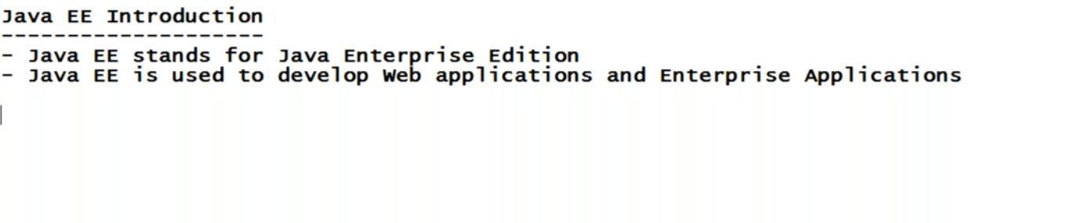

Slide 2
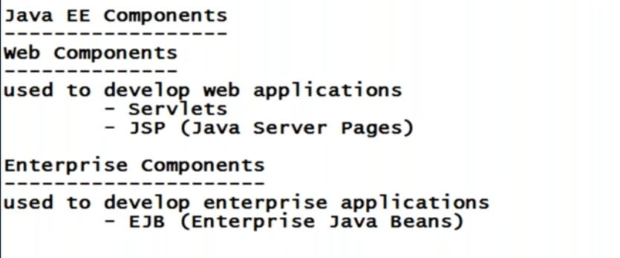
EJB is out dated , instead of EJB people are using spring frame work .

Slide 3
When you develop a java EE application or web application , is that web application is accessed by multiple users (clients) ?
So when you want your application to be accessed by multiple clients , what we need to do , we need to keep the application in a server .
Once we keep the application in server then only , that application is accessed by multiple clients .
In case of java , we have 2 types of servers , web server and application server .
Web servers are used to develop only web applications , that means web servers can understand only servlets and jsp .

Slide 4
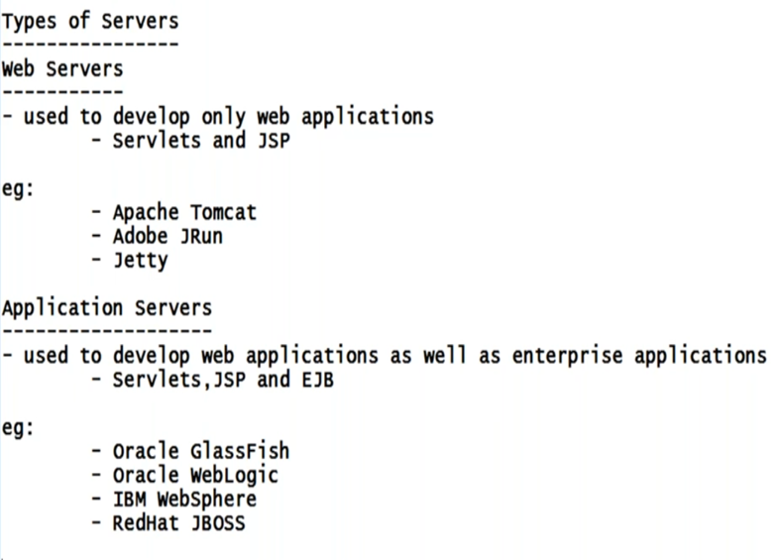
Means web servers can understand only servlets and JSP .
Means web server is a subset of Application server.

Slide 5
HTML vs Sevlets
HTML is used to develop static web pages .
In order to add dynamic content we can go with java script or jquery . But they are only for dynamic web pages not applications .
When you say application , it should able to connect to database , manage the transactions , provide security all the features should come . These features are some thing difficult in java script and jquery . That’s the reason we make use of servlets or jsp or php .

Slide 6
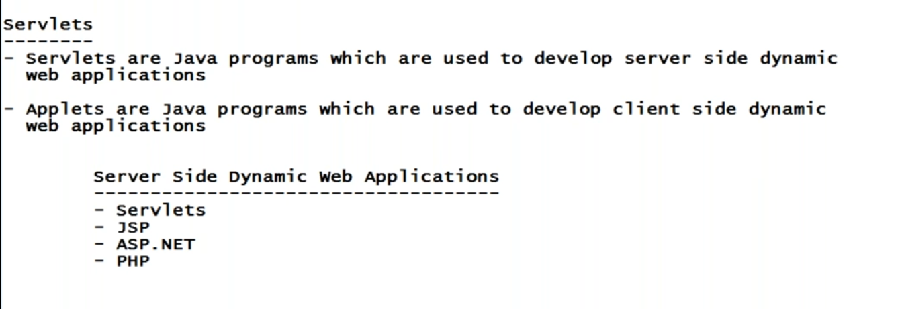
We can develop server side web applications using
Servlets
Java
Asp.net
php

Slide 7
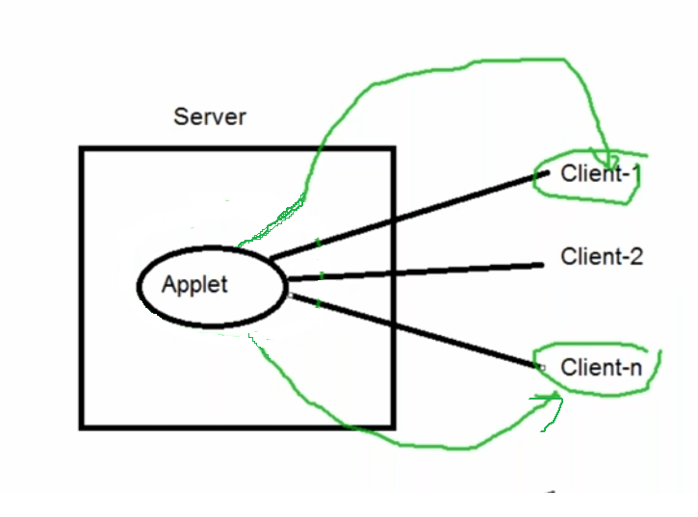

Slide 8
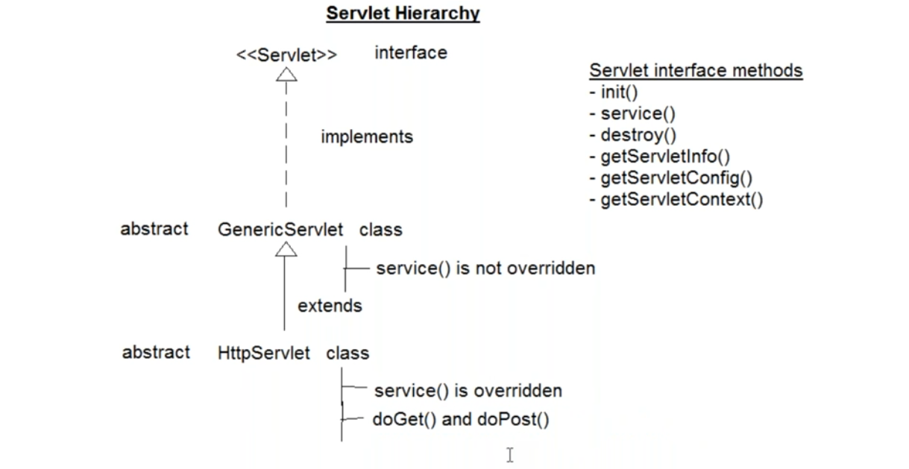

Slide 9
The top most interface under servlet is "Servlet“ interface.
interface contains abstract methods
1. public void init(ServletConfig config)
2. public void service(ServletRequest request,ServletResponse response)
3. public void destroy()
4. public ServletConfig getServletConfig()
5. public String getServletInfo()
GenericServlet class implements Servlet interface .
when a class implements an interface it has to provide implementation to all the methods(abstract) of that interface.
In GenericServlet class all the methods of Servlet interface have been overridden except service() method.
so GenericServlet class should be abstract class.

Slide 10
under this GenericServlet class we are having one more sub class called as HttpSevlet class.
This HttpSevlet extends GenericServlet class.
Because HttpSevlet class is extending GenericServlet class is has to override service() method.
Even though there are no abstract methods in HttpSevlet
class ,but still this class is abstract .
reason is we can not create object of abstract classes
, so java people decided or they want to form the rule ,
when ever you want to create a servlet you can not
use HttpSevlet class directly .
so create a (used defined) servlet you have create a class
by implementing Servlet interface or by extending
HttpSevlet or GenericServlet class.
when we create a servlet by extending HttpSevlet class
we even override two more methods(not rule) doGet()
and doPost()

Slide 11
Even though all the methods of HttpServlet class are concrete , java people declared it as abstract , because they don't want users to create object of this class .
So now when ever i want to create a servlet i can not use HttpServlet directly , i need to create my own user defined class that extends HttpServlet or GenericServlet.
when we extend HttpServlet , along with service() method we generally override two more methods (not rule) doGet() and doPost() .

Slide 12
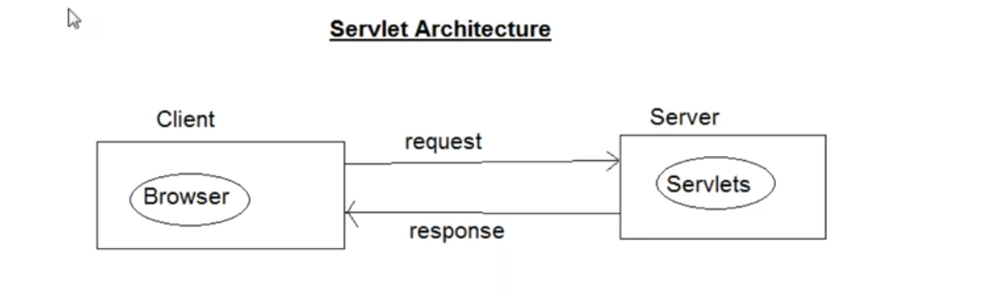

Slide 13
As an example when you say www.gmail.com you are making a request to gmail server , so in response what gmail will do ? it will display the login page.
So the data which is going from browser to servlet or server is managed with request.
The data which is coming from servlet or server to browser is called as response.

Slide 14
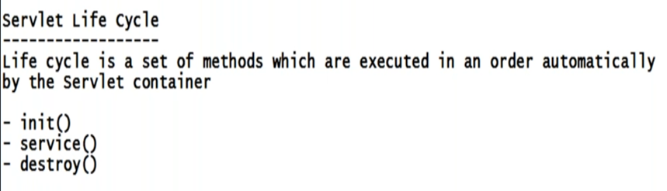

Slide 15
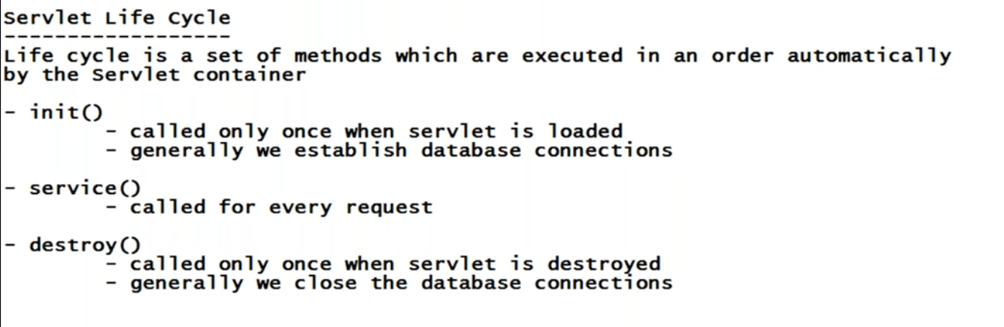
When you close the browser window the servlet will get destroyed.

Slide 16
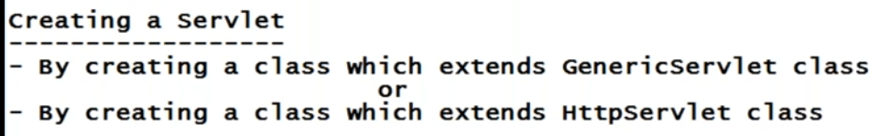

Slide 17
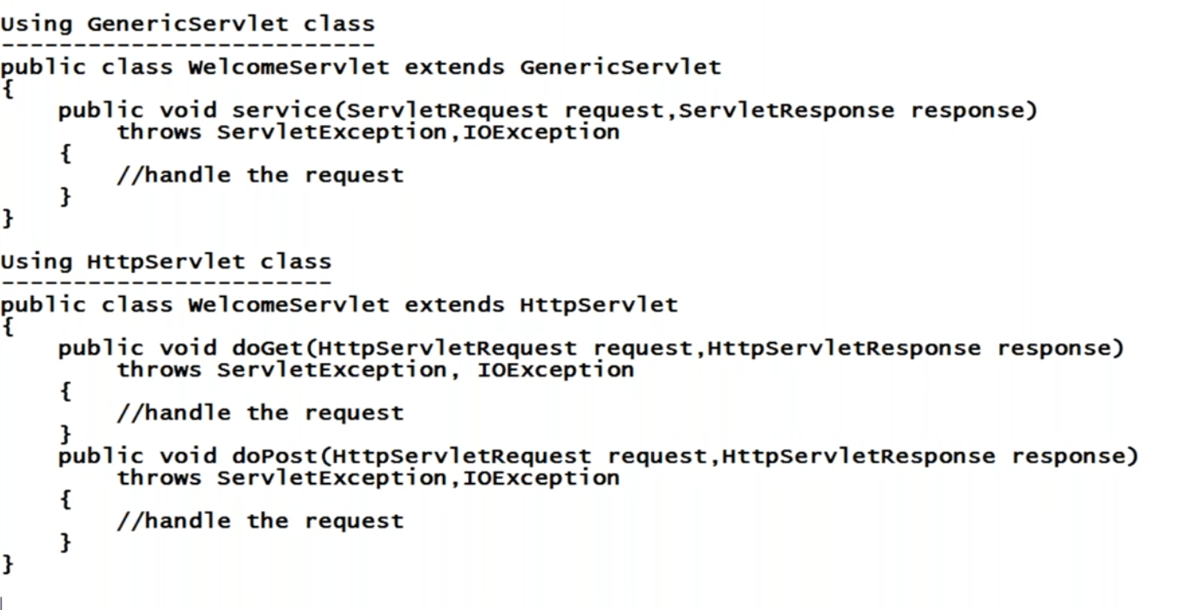
Servlets class must be public
So when ever you make a request it will invoke service() method.

Slide 18
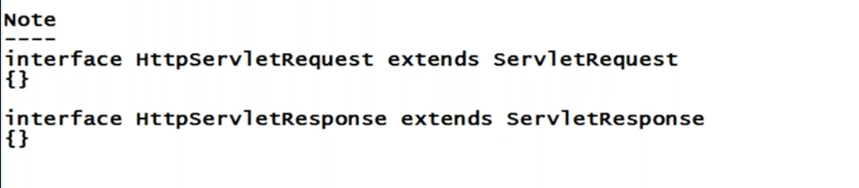
ServletRequest
and
ServletResponse
Are also interfaces.

Slide 19
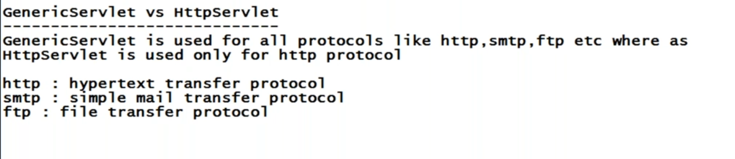
Now a days when ever you type any url in browser is it automatically going with http?
Yes , now a days maximum web applications are http.

Slide 21
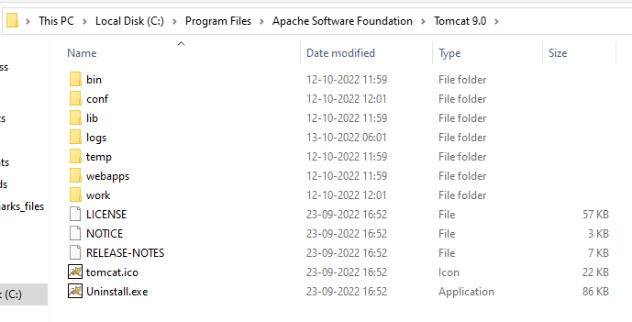

Slide 22
Always remember parent folder of “bin” is the home directory.

Slide 23
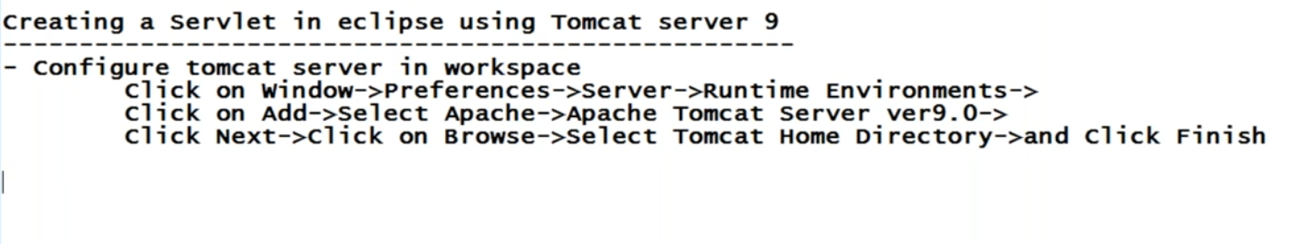

Slide 24
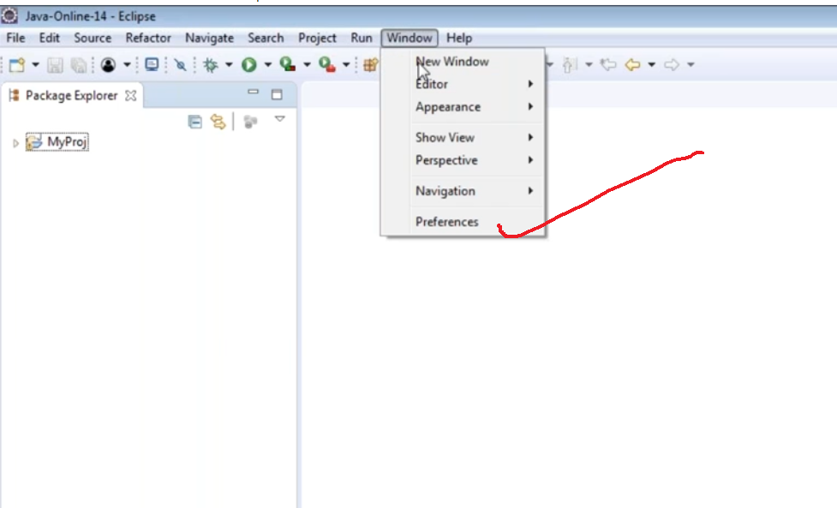

Slide 25
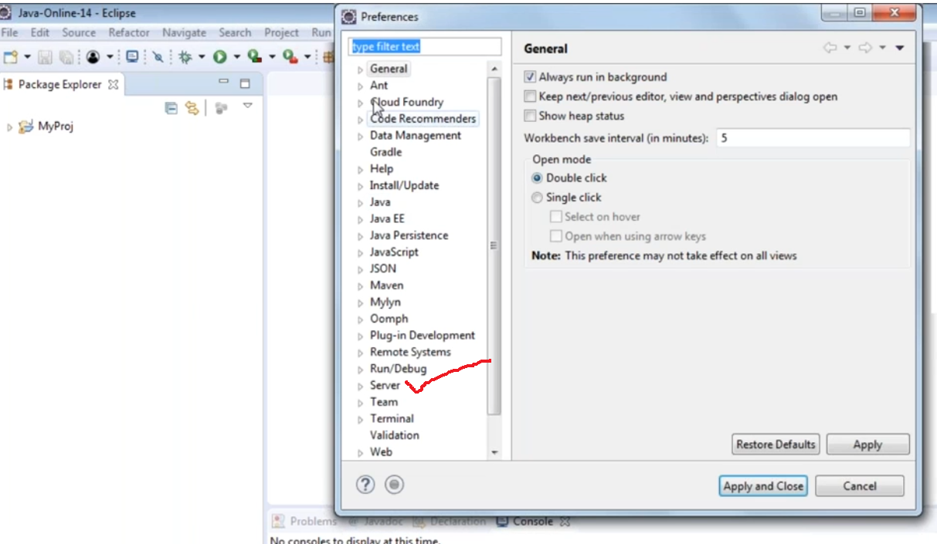

Slide 26
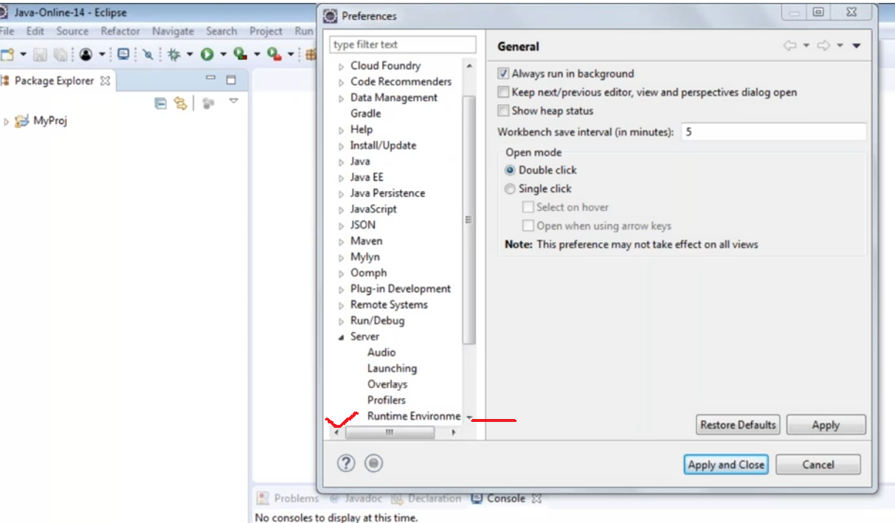

Slide 27
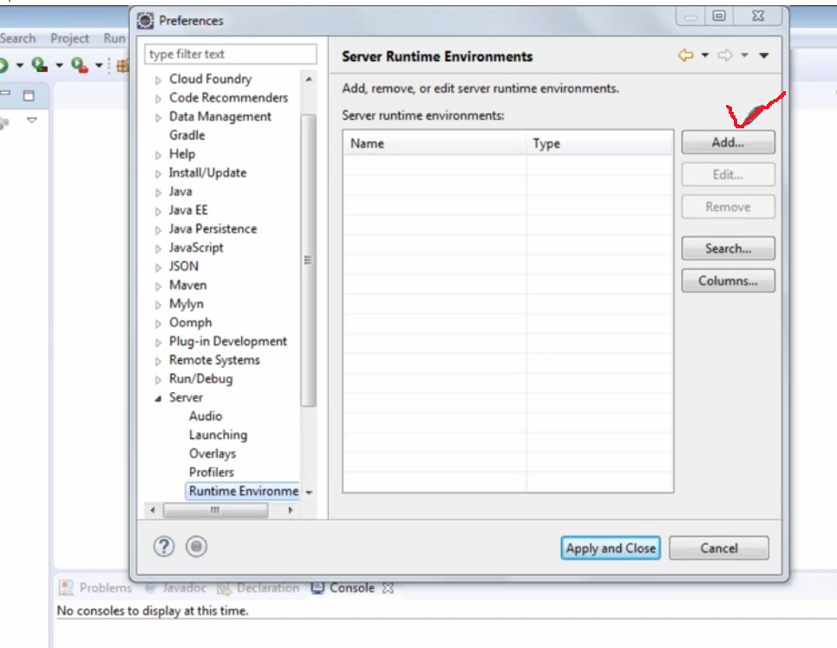

Slide 28
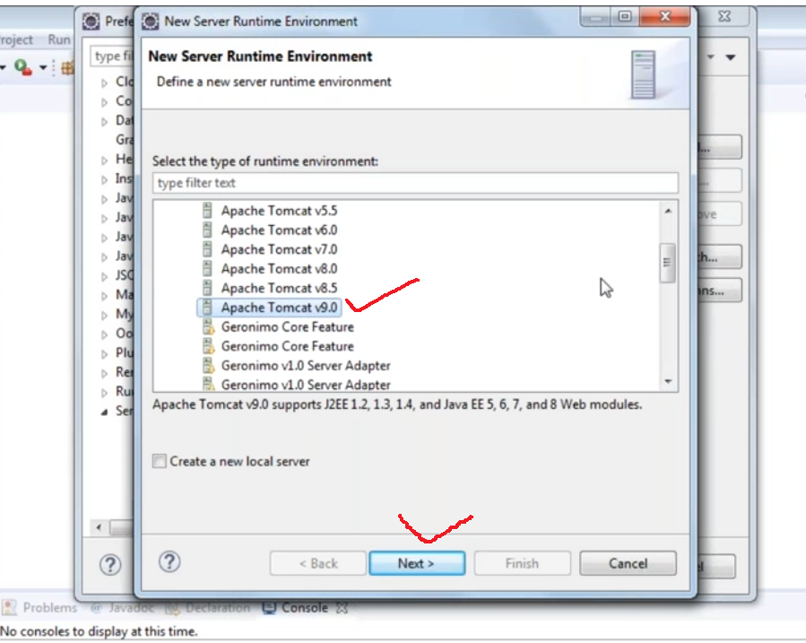

Slide 29
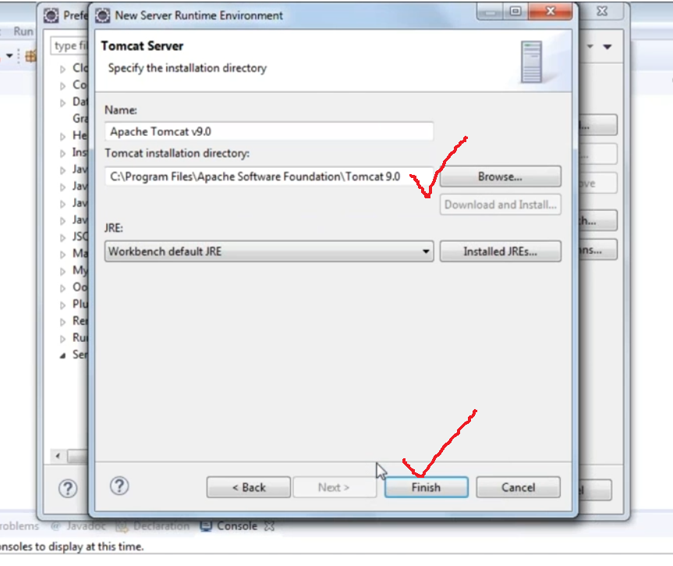

Slide 30
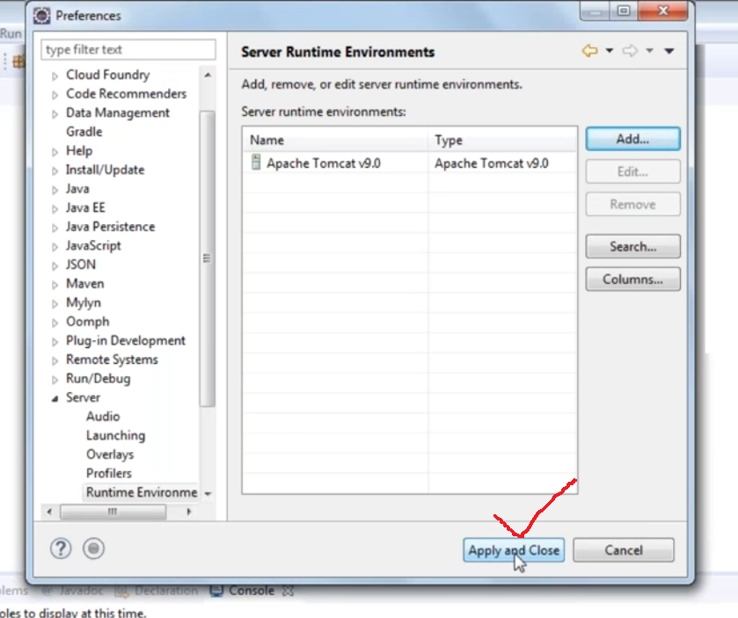

Slide 31
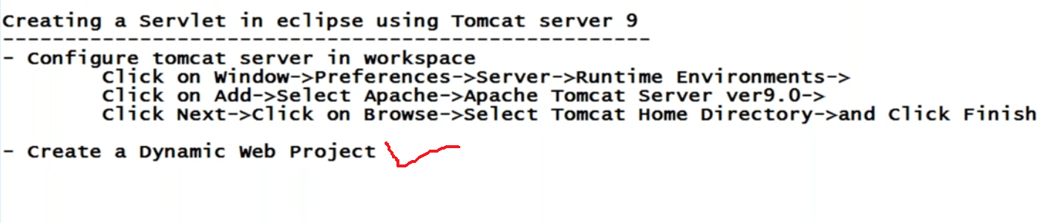
Servlets are used to create web applications
When you want to create a web application we have to create a different project
So we have to go with dynamic web project

Slide 32
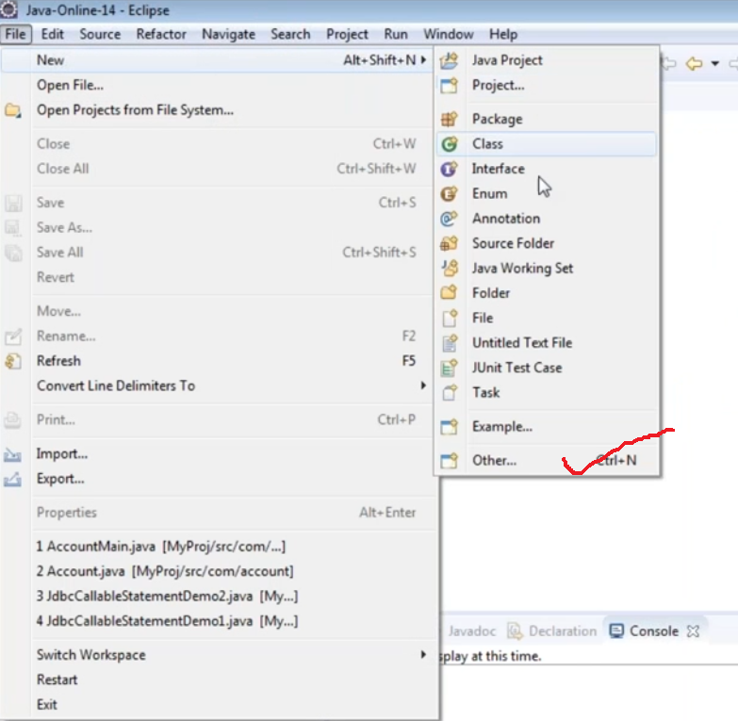

Slide 33
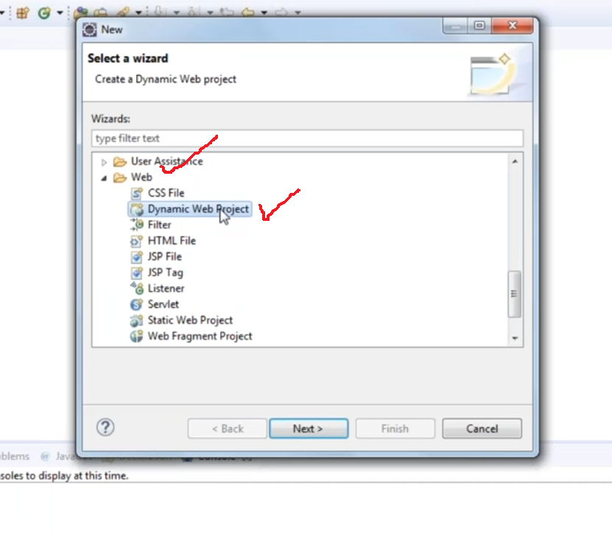

Slide 34
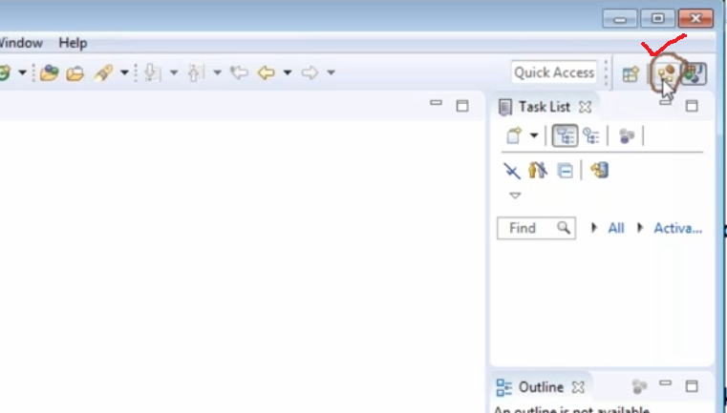
Or select java EE perspective from right most corner

Slide 35
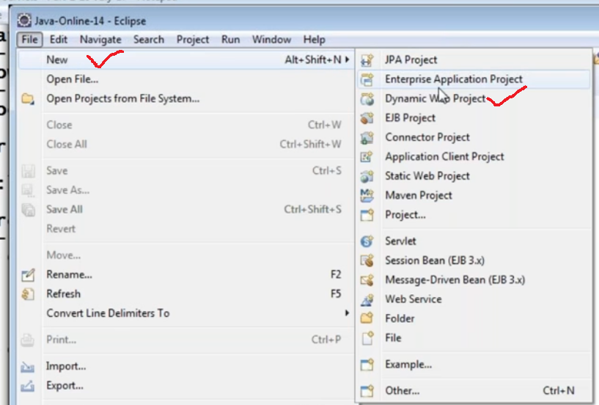

Slide 36
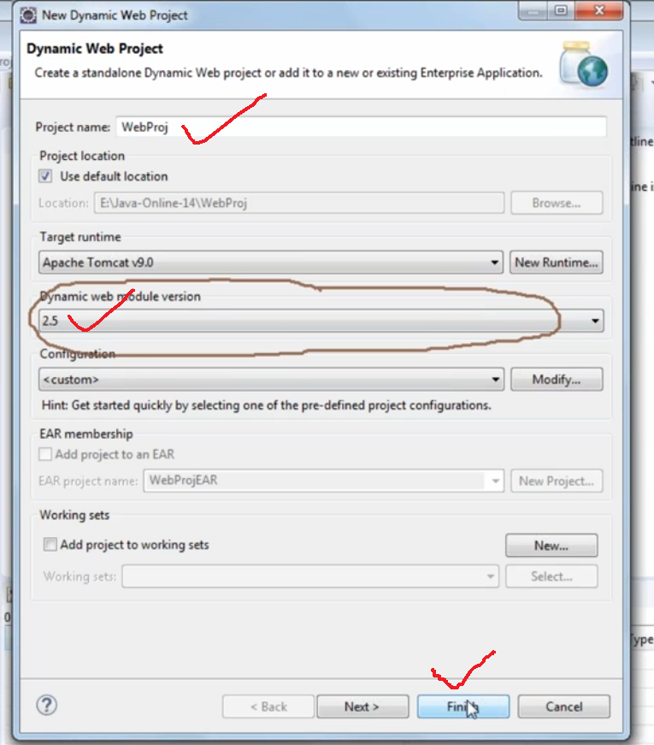

Slide 37
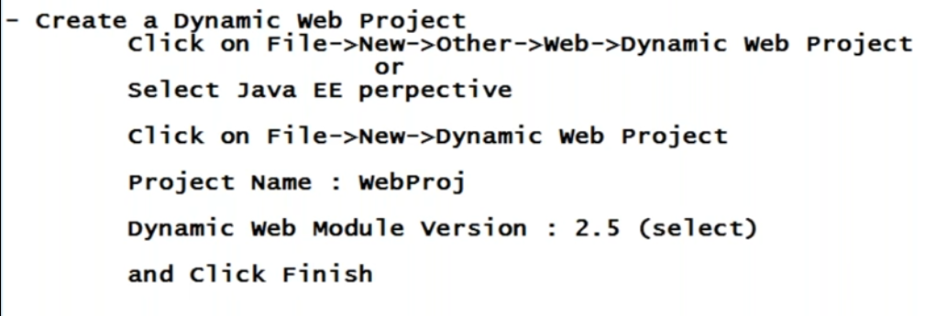

Slide 38
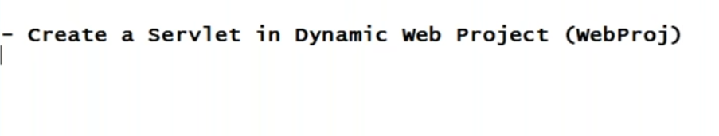

Slide 39
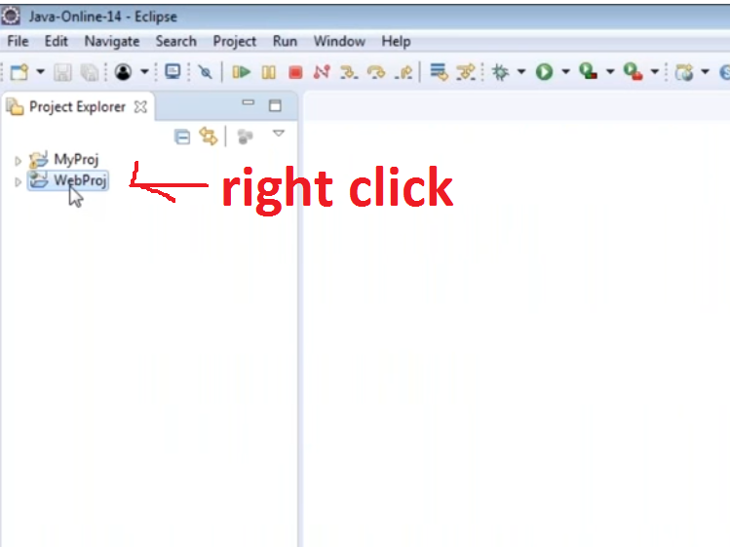

Slide 40
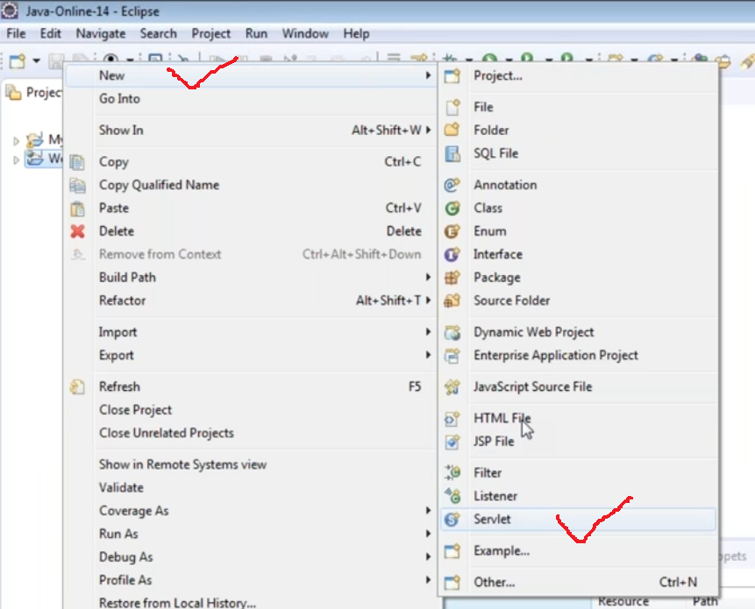

Slide 41
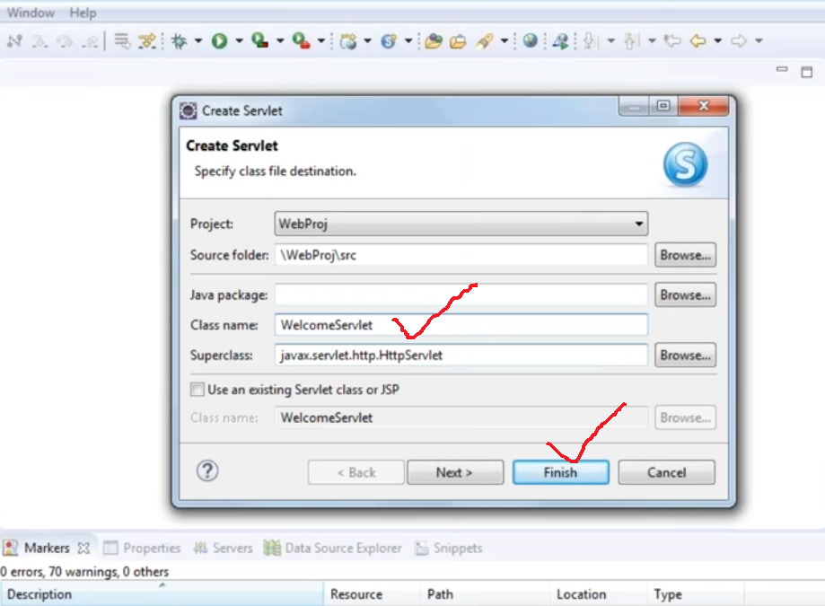

Slide 42
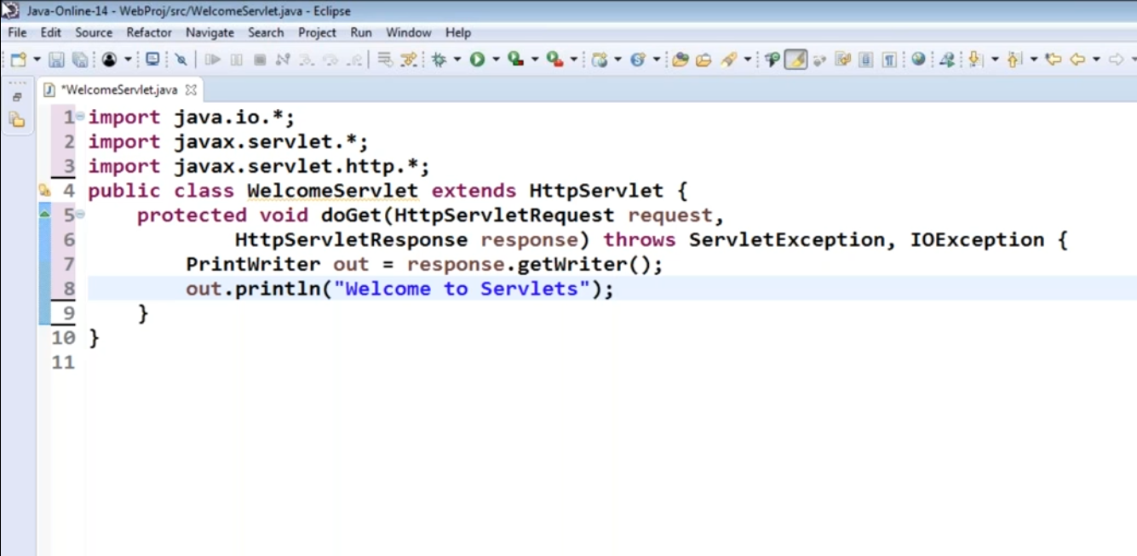

Slide 43
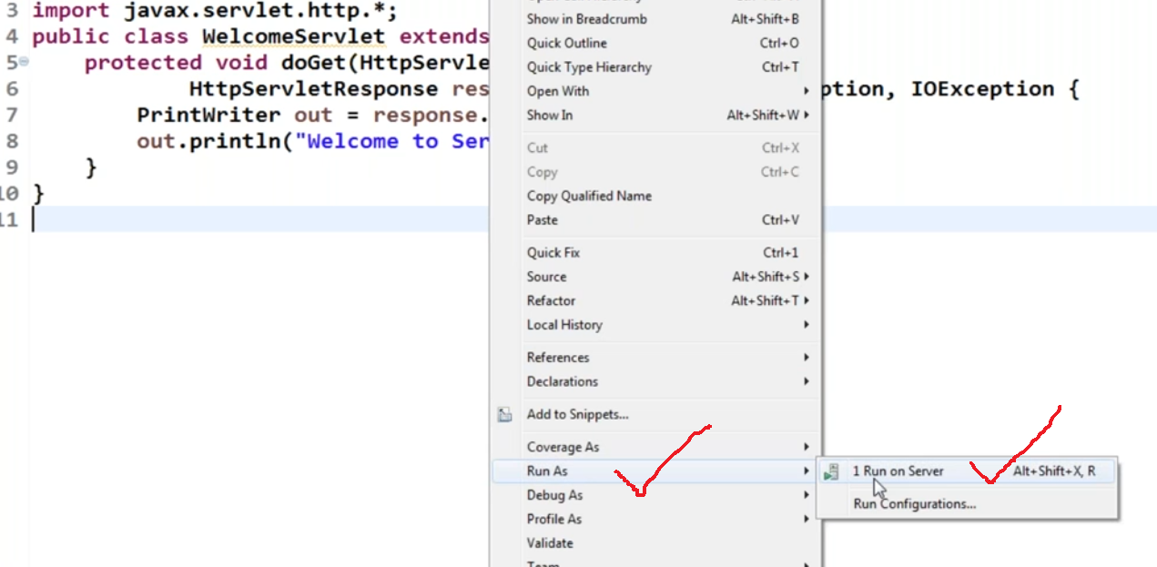

Slide 44
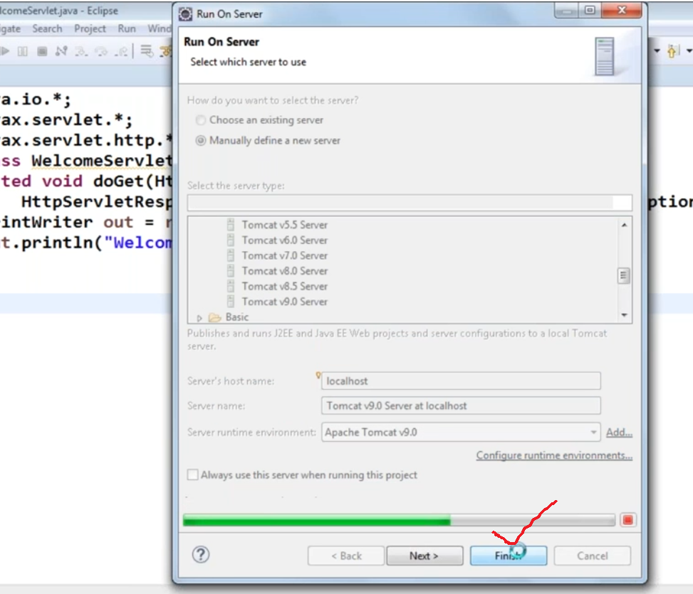

Slide 45
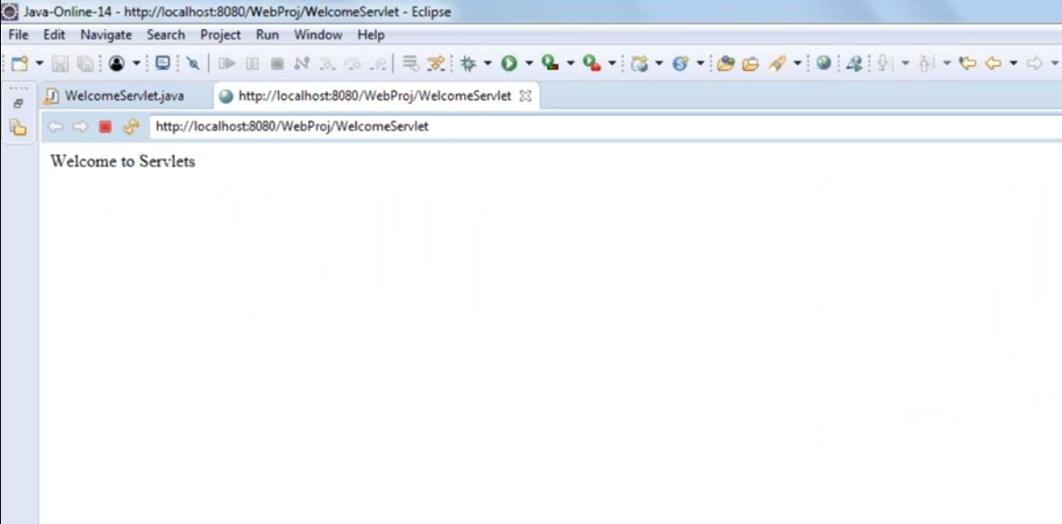
Copy the URL and you can run it in any browser

Slide 46
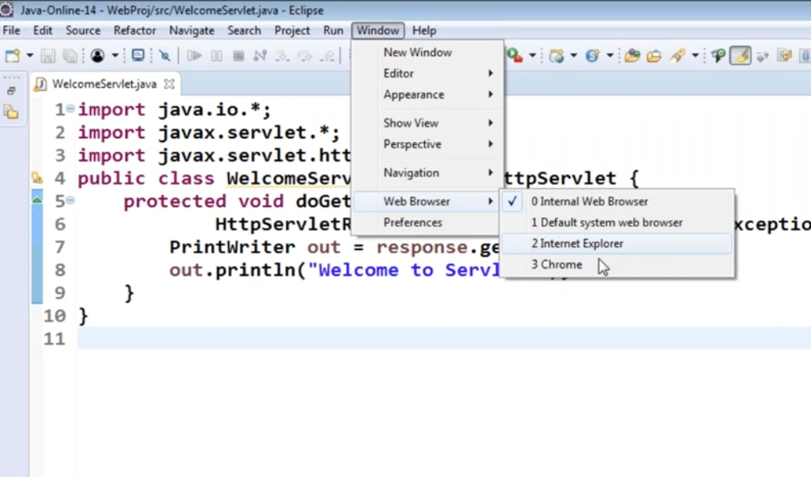

Slide 47
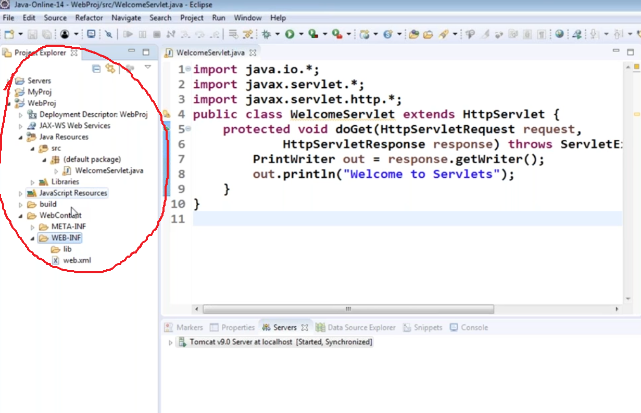

Slide 48
This web.xml file is very important , your servlet is running because of this web.xml.
If the project structure is not like this , then we can not go with Servlets
That’s the reason to make a project structure in this fashion we have to create a dynamic web project.
Java files are located in java resources → src folder

Slide 49
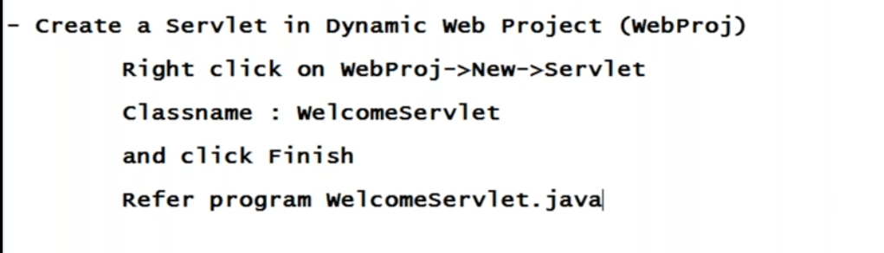

Slide 50
import java.io.IOException;
import java.io.PrintWriter;
import javax.servlet.ServletException;
import javax.servlet.http.HttpServlet;
import javax.servlet.http.HttpServletRequest;
import javax.servlet.http.HttpServletResponse;
public class WelcomeServlet extends HttpServlet {
protected void doGet(HttpServletRequest request, HttpServletResponse response) throws ServletException, IOException {
PrintWriter out=response.getWriter();
out.print("Welcome to First Servlet Program");
}
}

Slide 51
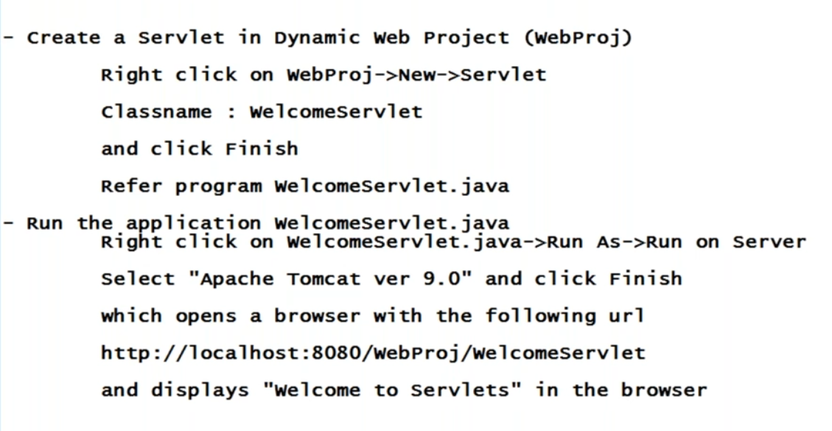

Slide 52
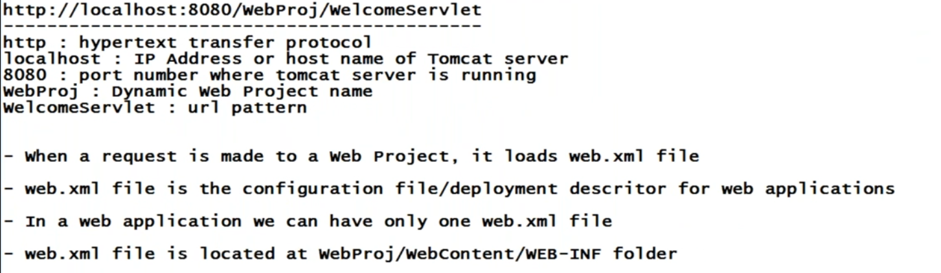

Slide 53
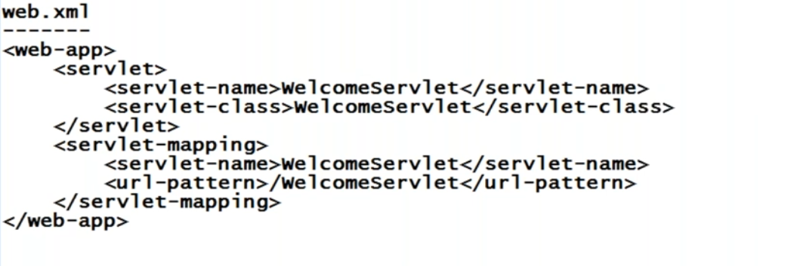

Slide 54
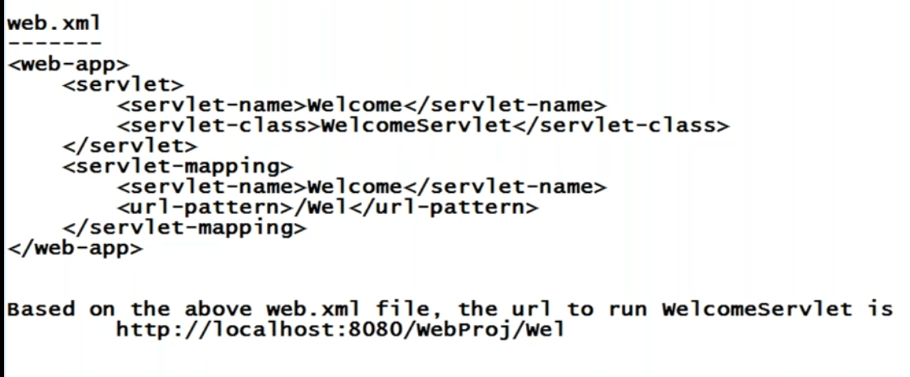

Slide 55
So when you give this URL first it will go to web project , under this web project it will load web.xml file and see the URL pattern and servletname and now goes the servlet name class and runs your welcome servlet.

Slide 56
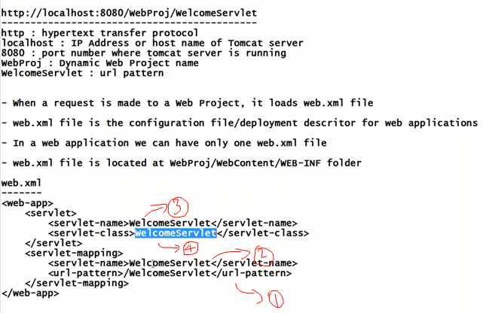

Slide 57
URL patterns plays major role in our web applications ,we refer to a particular servlet or even jsp files using URL pattern.

Slide 58
When you are running your application , you may get some issues , like your server is unable to start because of port number issues,it will say 8080 port number is already in use. Because if you install oracle express edition , it also will run at 8080 port .
So how to change port number when you are getting port number issues.

Slide 59
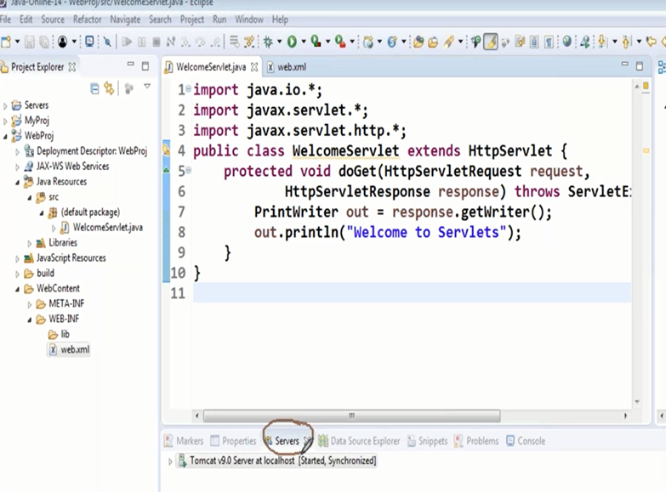

Slide 60
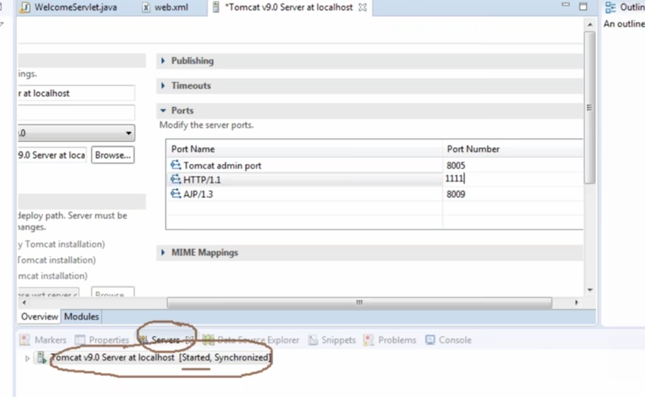

Slide 61
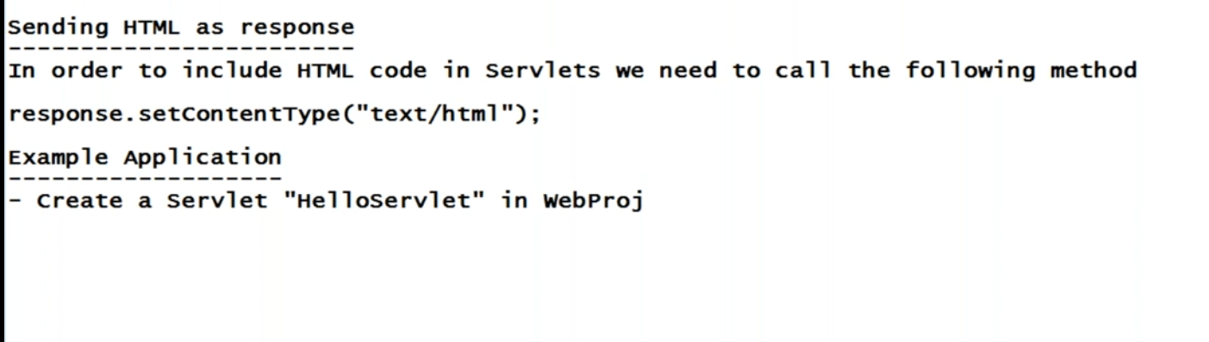

Slide 62
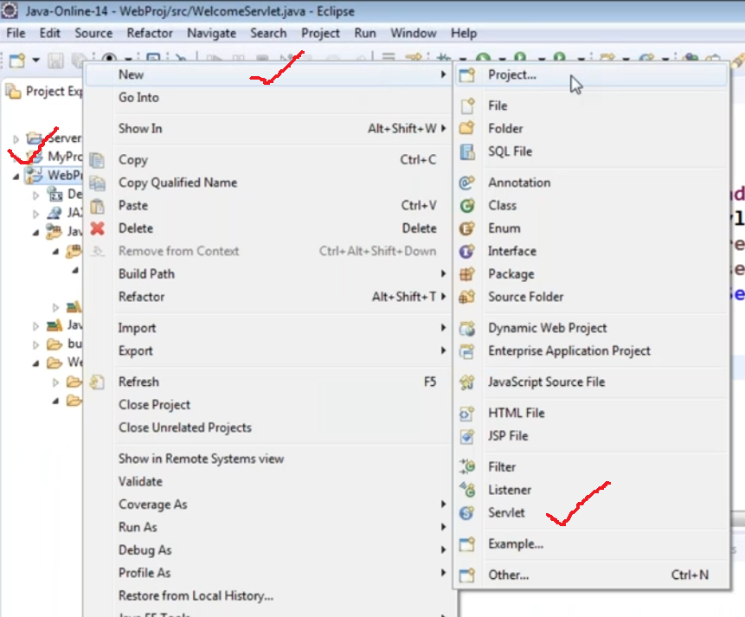

Slide 63
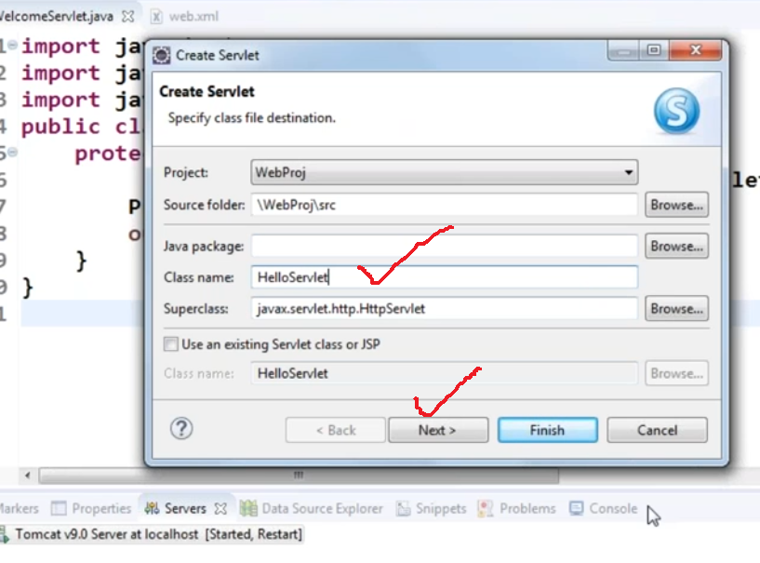

Slide 64


Slide 65


Slide 66


Slide 67


Slide 68


Slide 69


Slide 70
import java.io.IOException;
import java.io.PrintWriter;
import javax.servlet.ServletException;
import javax.servlet.http.HttpServlet;
import javax.servlet.http.HttpServletRequest;
import javax.servlet.http.HttpServletResponse;
public class HelloServlet extends HttpServlet {
protected void doGet(HttpServletRequest request, HttpServletResponse response) throws ServletException, IOException {
PrintWriter out = response.getWriter();
response.setContentType("text/html"); // optional
out.println("<html>");
out.println("<body>");
out.println("<font face=\"arial\" size=\"5\" color=\"blue\">Hello to all</font>");
out.println("</body>");
out.println("</html>");
}
}

Slide 71


Slide 72


Slide 74


Slide 75


Slide 76


Slide 77
To read form data into servlet we make use of a method request.getParameter() , why request ? Because the data is coming from browser to server i.e. servlet .
request.getParameter() Method return type is string . If you want to convert it into other type we have to use wrapper classes . In our example we are only displaying form data , so we need not do any conversions .

Slide 78


Slide 79


Slide 80


Slide 81


Slide 82


Slide 83


Slide 84


Slide 85


Slide 86


Slide 87


Slide 88


Slide 89


Slide 90
Now if you observe properly , what ever the data we are entering into the HTML form , it is visible in the URL .
For example in my HTML forms we are going to accept passwords , and once we click on submit , it will connect to a servlet , then will the password visible in URL ?
Yes .

Slide 91
So when you go for passwords we should not make it visible .
So when we are accepting passwords mainly , we don’t want send the data along with URL . We don’t want to make it visible in the URL . We want security .
Why the data is visible in URL is ? By default the HTTP protocol goes with get() method .

Slide 92


Slide 93
When ever you make a request to a servlet (i.e. making request means running our emp.html file) , which method will get executed ?
When ever you make a request for the first time , when the servlet is loaded , it will goto init() method .
Does your EmpServlet.java has init() method ? NO .
Does your HttpServlet has init() method ? NO .
HttpServlet is extending GenericServlet , in this class we have init() method , so it will execute init() method .

Slide 94
After init() method , it will goto service() method , service() method of HttpServlet will be called . In that service() method it will check whether the method call is get or post .
If the method call is get , then it will invoke doGet() method .
So your service() method of HttpServlet is taking care of invoking doGet() method . So if method is get , then the data goes along with the URL .
If you don’t want to send data along with the URL . We have to say method=“post” .

Slide 95
When you say method=“post” , now also it will connect to servlet , goes to HttpServlet class , invokes the service() method , then service() method will check the method call and if the method call is “post” , it going to invoke doPost() method . In doPost() we are invoking doGet() again .

Slide 96


Slide 97


Slide 98


Slide 99
Refer ReadingHtmlFormdata.war
And ReadingHtmlFormdata2.war

Slide 100

In future if I add one more field , I need not touch my CardServlet , for example if I say Card Type , visa or master card , then with out touching my CardServlet , it should automatically create the table .
So even if I modify my HTML form I should not touch my CardServlet .
How to manage this ? For this we have to use some more methods .

Slide 101


Slide 102
In case of getParameter() method we have to pass input parameter name and it will give the value. If you are not aware of input parameter name ? or if you have 50+ input values its really tedious to use getParameter() method.
That’s why this getParameterNames() came into picture

Slide 103


Slide 104
Refer GetParameterNames.war
And GetParameterValues.war

Slide 105
Servlet to Servlet Communication

Slide 106


Slide 107


(we will not send any data we will just forward the request)

Slide 108


Slide 109


Slide 110


Slide 111

Dialog box
When you click on “ok” button we want to connect back to this “login.html” page.

Slide 112


Slide 113

Let us suppose we entered
Username : bbb
Password : bbb

Slide 114

When login failed we want to connect to register servlet.

Slide 115


Slide 116


Slide 117


Slide 118


Slide 119


Slide 120


Slide 121
create table users(username varchar(10) , password varchar(10));
mysql> insert into users values('aaa','aaa');

Slide 122


Slide 123


Slide 124


Slide 125


Slide 126


Slide 127


Slide 128


Slide 129


Slide 130
import java.io.*;
import java.sql.Connection;
import java.sql.DriverManager;
import java.sql.PreparedStatement;
import java.sql.ResultSet;
import java.sql.SQLException;
import javax.servlet.*;
import javax.servlet.http.*;
import javax.swing.JOptionPane;
public class LoginServlet extends HttpServlet {
Connection con;
public void init(ServletConfig config)
{
try {
Class.forName("com.mysql.jdbc.Driver");
con=DriverManager.getConnection("jdbc:mysql://localhost:3306/mydb","root","root");
} catch (Exception e) {
e.printStackTrace();
}
}
LoginServlet.java

Slide 131
protected void doGet(HttpServletRequest request, HttpServletResponse response) throws ServletException, IOException {
PrintWriter out=response.getWriter();
String username=request.getParameter("username");
String password=request.getParameter("password");
try {
PreparedStatement st=con.prepareStatement("select * from users where username='"+username+"' and password='"+password+"'");
ResultSet rs=st.executeQuery();
if(rs.next())
{
JOptionPane.showMessageDialog(null, "Login Successful");
response.sendRedirect("/LoginProject/login.html");
}
else {
JOptionPane.showMessageDialog(null,"Login Not Successful");
RequestDispatcher rd=request.getRequestDispatcher("/RegisterServlet");
rd.forward(request, response);
}
st.close();
}

Slide 132
catch (Exception e) {
e.printStackTrace();
}
}
protected void doPost(HttpServletRequest request, HttpServletResponse response) throws ServletException, IOException {
doGet(request, response);
}
public void destroy()
{
try {
con.close();
} catch (SQLException e) {
e.printStackTrace();
}
}
}

Slide 133


Slide 134


Slide 135


Slide 136


Slide 137


Slide 138
Refer LoginProject.war

